Slide 1

AGB1211 – DESIGN THINKING
Department of Artificial Intelligence and Data Science
Academic Year: 2024 – 2025 (Odd Semester)
Year : II
Semester :III
Section :A
Date :05/12/2024
PRESENTED BY
S. JULIAN FIDAL CASTRO
2. S. KAMALESH
3. T. KANISHKAR
4. K. KAPIL

Slide 2
Title of the Project
Learn/Play for Nomad Children

Slide 3
Problem Identification
Lack of consistent education for nomadic children due to frequent movement and limited resources.
Conventional educational tools are inaccessible in remote and rural areas.
Lack of engagement with culturally relevant and adaptable learning content.

Slide 4
Objective
Bridge educational gaps for nomadic children through a playful and interactive app.
Provide offline-accessible educational resources.
Create culturally relevant and adaptive learning modules.

Slide 5
BrainStorming
Flexible Learning Spaces
Outdoor Classrooms
Field-Based Learning
Practical Skill Training
Peer Learning Networks
Virtual Classrooms
- Family Learning Kits
Culturally Relevant Content
Local Expert Engagement
Offline Educational Apps
Adaptive Learning Platforms
Educational Games
- Mobile Learning Units
- Pop-Up Learning Hubs

Slide 6
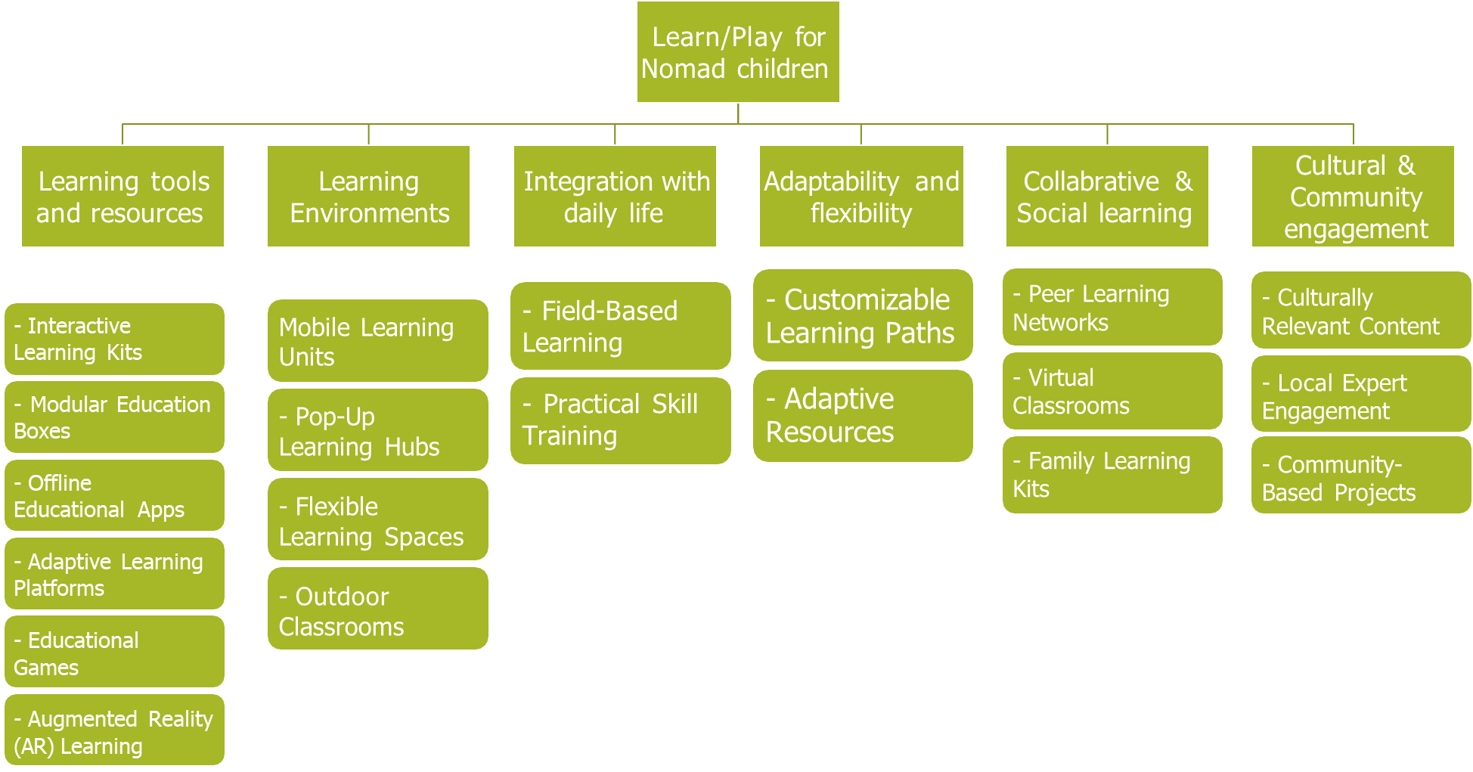
Mind Map

Slide 7
Primary Research
What We Did:
Interviewed nomadic families and educators.
Analyzed educational challenges faced by nomadic children. Findings:
High demand for offline tools.
Children engage better with interactive and visual content.

Slide 8
Secondary Research
Researched similar apps and educational tools. Findings:
Gamified apps have higher engagement rates.
Offline access is critical in remote areas.

Slide 9
Proposed Work
What Our App Offers:
Interactive learning modules tailored for nomadic children.
Offline games and activities for skill development.
Portable classrooms for collaborative learning.

Slide 10
List of Modules
Learning Modules: Math, Science, and Stories.
Puzzle Games: Memory Match, Word Search, and Logic Riddles.
Mobile Classrooms: Portable setups for education anywhere.

Slide 11
Learning Modules
Engaging content in Math, Science, and Storytelling.
Offline accessible for consistent learning.
Adaptive design based on user progress.

Slide 12
Puzzle Games
Memory Match, Word Search, and Logic Riddles.
Boosts problem-solving and logical reasoning skills.
Dynamic difficulty levels for continued engagement.

Slide 13
Mobile Classrooms
Portable classrooms equipped with digital and physical resources.
Hands-on learning kits for collaborative projects.
Flexible setups for remote or rural areas.
:

Slide 14
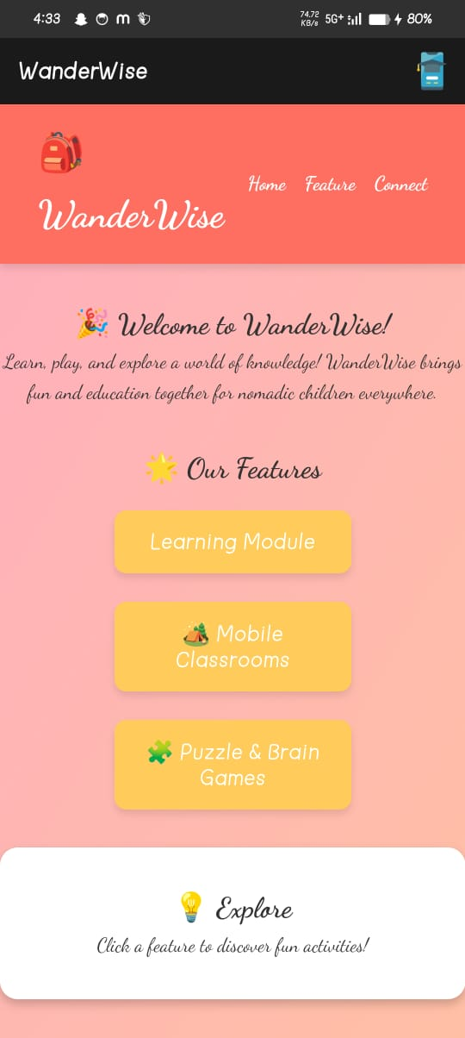
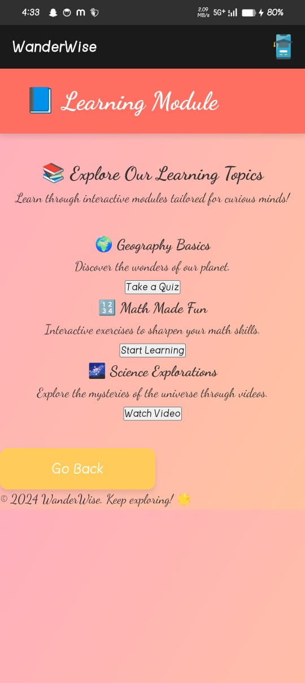
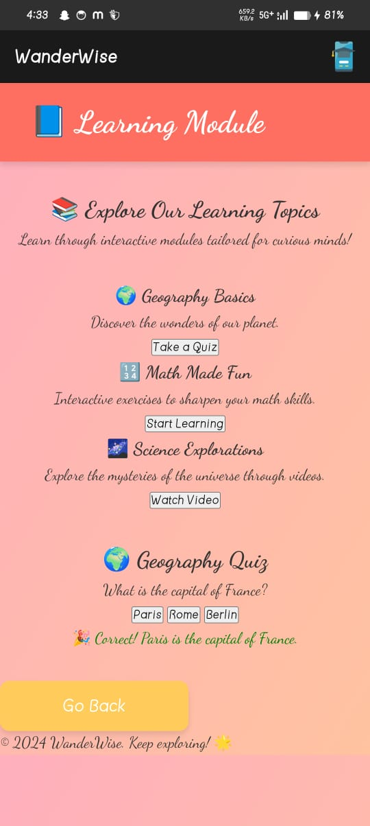
Results

Slide 15
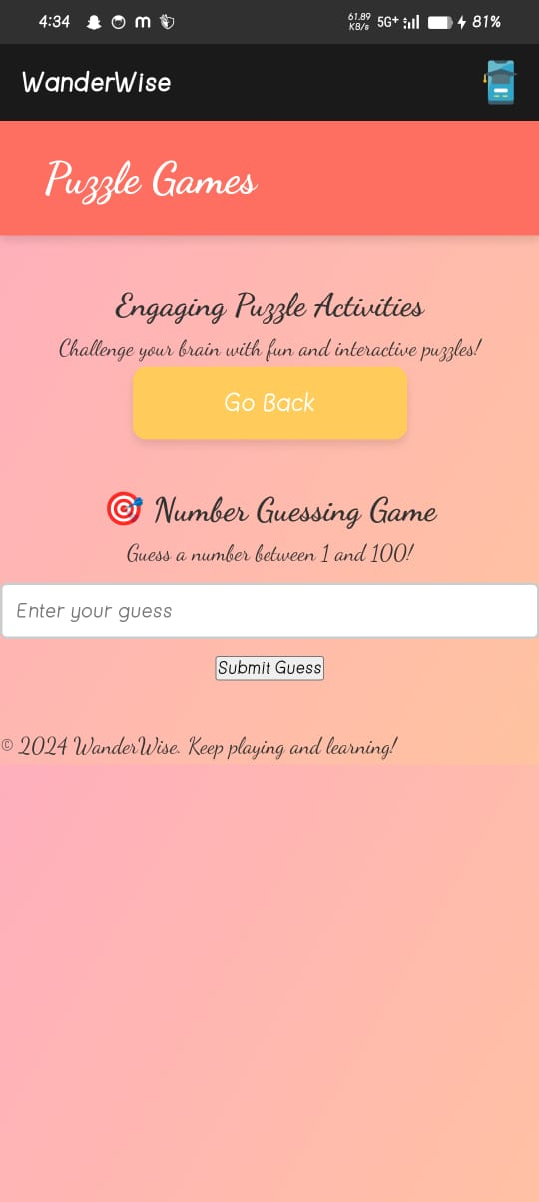
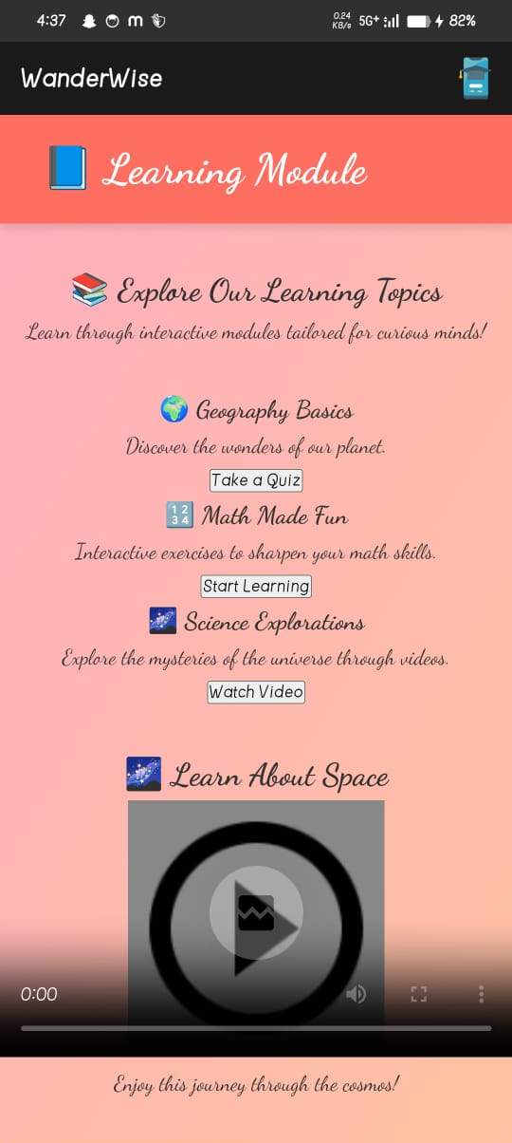
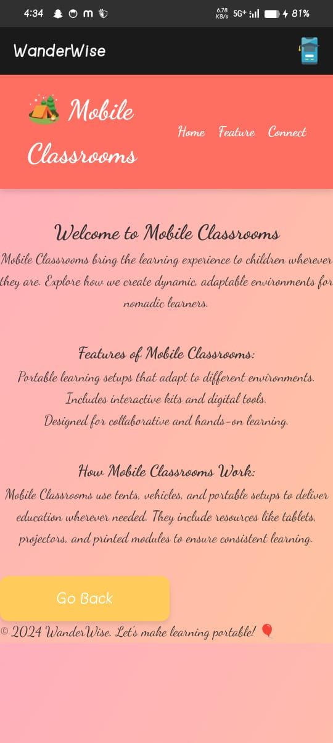
Results

Slide 16
Conclusion
Learn/Play for Nomad Children makes learning accessible and fun for underserved communities.
Combines gamified, interactive content with cultural relevance and offline features.

Slide 17
Thank You
Any queries???

